Slide 1



Sequential Logic Synthesis
Giovanni De Micheli
Integrated Systems Laboratory
This presentation can be used for non-commercial purposes as long as this note and the copyright footers are not removed
© Giovanni De Micheli – All rights reserved

Slide 2
Module 1
Objective
  Motivation and assumptions for sequential synthesis
  Finite-state machine design and optimization

Slide 3
Synchronous logic circuits
Interconnection of
  Combinational logic gates
  Synchronous delay elements
    Edge-triggered, master/slave
Assumptions
  No direct combinational feedback
  Single-phase clocking
Extensions to
  Multiple-phase clocking
  Gated latches
Notes:
Synchronous logic circuits consist of interconnections of combinational logic gates and registers. Thus, synchronous sequential circuits are often modeled by a combinational circuit component and registers.
We assume here, for the sake of simplicity, that registers are edge-triggered and store one bit of information. We also assume that there is only one system clock.
Most of the techniques described in this chapter can be extended to the case of level-sensitive latches and of multiple-phase clocks.

Slide 4
Modeling synchronous circuits
Circuit are modeled in hardware languages
  Circuit model may be directly related to FSM model
    Description by: switch-case
  Circuit model may be structural
    Explicit definition of registers
Sequential circuit models can be generated from high-level models
  Control generation in high-level synthesis
Notes:
Sequential circuits can be specified in terms of HDL models or synthesized.
In both cases, the sequential circuit model may have either a behavioral or a structural flavor, or a combination of both.

Slide 5
Modeling synchronous circuits
State-based model:
  Model circuits as finite-state machines (FSMs)
  Represent by state tables/diagrams
  Apply exact/heuristic algorithms for:
    State minimization
    State encoding
Structural model
  Represent circuit by synchronous logic network
  Apply
    Retiming
    Logic transformations
Notes:
A convenient way to express the circuit behavior is by means of FSM models, e.g. state-transition diagrams. Thus, state-based representations have a behavioral flavor.
An alternative representation of the circuit behavior is by means of logic expressions in terms of time-labeled variables. As in the case of combinational circuits, it is often convenient to express the input/output behavior by means of a set of local expressions with mutual dependencies. This leads to circuit representations in terms of synchronous logic networks that express the interconnection of combinational modules and registers,

Slide 6
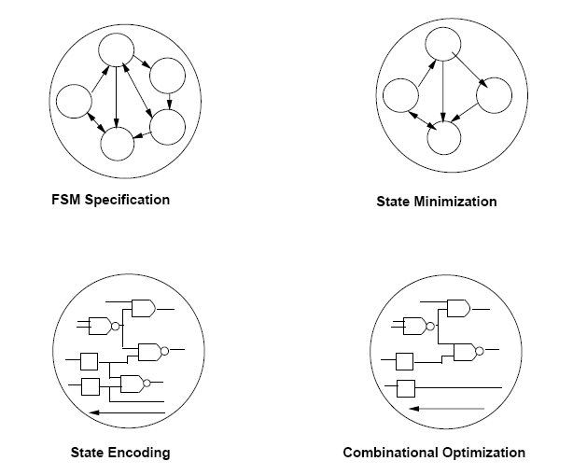
State-based optimization
Notes:
Schematic flow of FSM optimization

Slide 7
Modeling synchronous circuits
Advantages and disadvantages of models
State-based model
  Explicit notion of state
  Implicit notion of area and delay
Structural model
  Implicit notion of state
  Explicit notion of area and delay
Transition from a model to another is possible
  State encoding
  State extraction
Notes:
There are advantages and disadvantages for both models. Optimization methods target both representations. Besides, it is possible to go from one representation style to the other by means of transformations, such as state encoding and state extraction.

Slide 8
Sequential logic optimization
Typical flow
  Optimize FSM state model first
    Reduce complexity of the model
    E.g., apply state minimization
    Correlates to area reduction
  Encode states and obtain a structural model
    Apply retiming and transformations
    Achieve performance enhancement
  Use state extraction for verification purposes
Notes:
A typical flow in sequential optimization targets the FSM models first.
Here state minimization attempts to reduce the size of the representation.
State encoding then maps the state-based model into a network model.
Circuit performance can be enhanced by retiming.
If desirable, state extraction can be used to obtain a state-based representation of the optimized circuit, possibly for verification but also for further optimization purposes.

Slide 9
Formal finite-state machine model
A set of primary input patterns X
A set of primary output patterns Y
A set of states S
A state transition function: δ: X × S → S
An output function:
  λ: X × S → Y for Mealy models
  λ: S → Y for Moore models
Notes:
This is the standard FSM definition

Slide 10
State minimization
Classic problem
  Exact and heuristic algorithms are available
  Objective is to reduce the number of states and hence the area
Completely-specified finite-state machines
  No don’t care conditions
  Polynomial-time solutions
Incompletely-specified finite-state machines
  Unspecified transitions and/or outputs
    Usual case in synthesis
  Intractable problem:
    Requires binate covering
Notes:
The state minimization problem aims at reducing the number of machine states.
This leads to a reduction in size of the state-transition graph.
State reduction may correlate to a reduction of the number of storage elements.
(When states are encoded with a minimum number of bits, the number of register
is the ceiling of the logarithm of the number of states.)
The reduction in states correlates to a reduction in transitions, and hence to a reduction of logic gates.
State minimization can be defined informally as deriving a FSM with similar behavior and minimum number of states.
A more precise definition relies on choosing to consider completely (or incompletely)
specified FSM. This decision affects the formalism, the problem complexity and the algorithms. Hence state minimization is described separately in the two cases.

Slide 11
State minimization for completely-specified FSMs
Equivalent states:
  Given any input sequence, the corresponding output sequence match
Theorem:
  Two states are equivalent if and only if:
    They lead to identical outputs and their next-states are equivalent
Equivalence is transitive
  Partition states into equivalence classes
  Minimum finite-state machine is unique
Notes:
When considering completely specified FSMs, the transition function and the output function are specified for each pair (input, state) . Two states are equivalent if the output sequences of the FSMS initialized in the two states coincide for any input sequence.
Since equivalency is symmetric, reflexive and transitive, states can be partitioned into equivalence classes. Such a partition is unique.
A minimum-state implementation of a FSM is one where each state represents only one class, or equivalently where only one state per class is retained.

Slide 12
State minimization for completely-specified FSMs
Stepwise partition refinement:
  Initially:
    All states in the same partition block
  Iteratively:
    Refine partition blocks
  At convergence:
    Partition blocks identify equivalent states
Refinement can be done in two directions
  Transitions from states in block to other states
    Classic method. Quadratic complexity
  Transitions into states of block under consideration
    Inverted tables. Hopcroft’s algorithm.
Notes:
Minimizing the number of states of a completely specified FSMs entails then computing the equivalence classes.
These can be derived by an iterative refinement of a partition of the state set.
At first, blocks of partition P1 contain states whose outputs match for any input, hence satisfying a necessary condition of equivalence.
Then, partition blocks are iteratively refined by further splittings, by requiring that all states in any block of Pi+1 have next-states in the same block of Pi for any possible input.
When the iteration converges for some value of I, i.e. when Pi+1 = Pi the corresponding blocks are equivalence classes.

Slide 13
Example of refinement
Initial partition:
  Π₁ : States belong to the same block when outputs are the same for any input
Iteration:
  Π_{k+1} : States belong to the same block if they were previously in the same block and their next states are in the same block of Π_{k} for any input
Convergence:
  Π_{k+1} = Π_{k}
Notes:
This slide repeats the procedure in a more formal way.

Slide 14
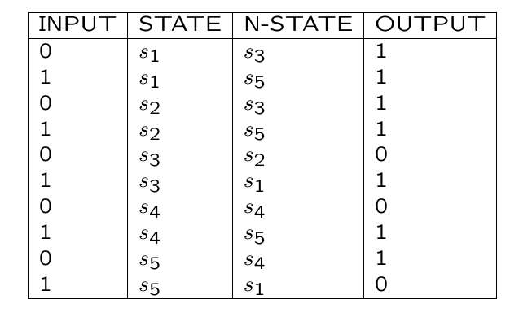
Example
Notes:
Initial state table – fully specified.

Slide 15
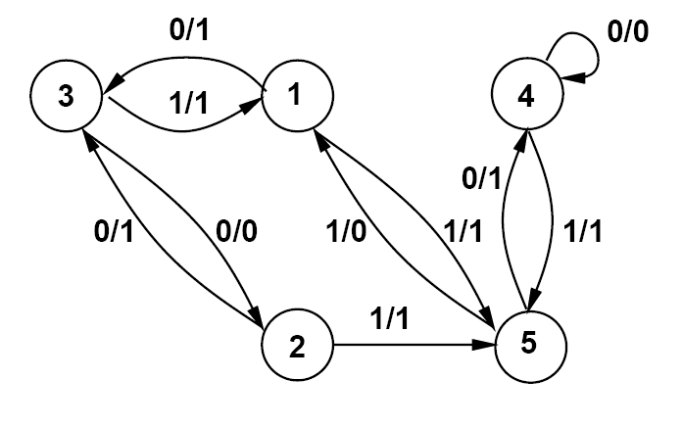
Example
Notes:
State diagram corresponding to the state table.

Slide 16
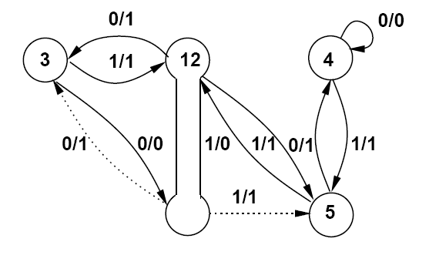
Example
Π₁ = { { s₁, s₂} , { s₃,s₄ }, { s₅ } }
Π₂ = { { s₁, s₂} , { s₃} , { s₄ }, { s₅ } }
Π₂ is a partition into equivalence classes
  No further refinement is possible
  States { s₁, s₂ } are equivalent
Notes:
Example of partition refinement.
States 1 and 2 can be merged; they are shown by the bone in the diagram.
Dotted edges are redundant and can be removed.

Slide 17
State minimization for incompletely-specified finite-state machines
Applicable input sequences
  All transitions are specified
Compatible states
  Given any applicable input sequence, the corresponding output sequence match
Theorem:
  Two states are compatible if and only if:
    They lead to identical outputs
      (when both are specified)
    And their next state is compatible
      (when both are specified)
Notes:
In the case of incompletely specified FSMs, the transition function and the output function are not specified for some (input, state) pairs. Equivalently, dc conditions denote the unspecified transitions and outputs. They model the knowledge that some input patterns
cannot occur in some states or that some outputs are not observed in some states under some input conditions.
An input sequence is said to be applicable if it does not lead to any unspecified transition.
Two states are compatible if the output sequences of the FSMs initialized in the two states coincide whenever both outputs are specified and for any applicable input sequence.

Slide 18
State minimization for incompletely-specified finite-state machines
Compatibility is not an equivalence relation
Minimum finite-state machine is not unique
Implication relation make the problem intractable
  Two states may be compatible, subject to other states being compatible.
  Implications are binate satisfiability clauses
    a -> b = a’+b
Notes:
There are two major differences with respect to the case of completely specified FSMs.
First, compatibility is not an equivalency relation, because compatibility is a symmetric and reflexive relation, but not transitive.
A class of compatible states is then defined to be such that all its states are pairwise compatible. Maximal classes of compatible states do not form a partition of the state set. Since classes may overlap, multiple solutions to the problem may exist. The intractability of the problem stems from this fact.
Second, the selection of an adequate number of compatibility classes to cover the state set is complicated by implications among the classes themselves, because the compatibility of two or more states may require the compatibility of others.
Hence the selection of a compatibility class to be represented by a single state, may imply that some other class has also to be chosen.
A set of compatibility classes has the closure property when all implied compatibility classes are in the set or contained by classes in the set.

Slide 19
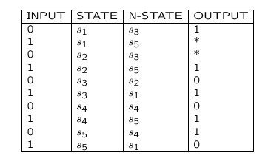
Example
Notes:
State table of incompletely specified FSM.

Slide 20
Trivial method
Consider all possible don’t care assignments
  n don’t care imply
    2^{n} completely specified FSMs
    2^{n} solutions
Example:
  Replace * by 1
    Π₁ = { { s₁, s₂} , { s₃}, {s₄ }, { s₅ } }
  Replace * by 0
    Π₁ = { { s₁, s₅} , { s₂,s₃ , s₄ } }
Notes:
Note that replacing the dc entries by 1s would lead to the table of the previous example, that can be minimized to four states.
Other choices of the dc entries would lead to other completely specified FSMs.
Unfortunately, there is an exponential number of completely specified FSMs in correspondence to the choice of the dc values

Slide 21
Compatibility and implications
Example
Compatible states {s₁ , s₂}
If {s₃ , s₄} are compatible
  Then {s₁ , s₅ } are also compatible
Incompatible states {s₂ , s₅}
Notes:
By comparing state pairs, you can have the following cases:
The states are compatible
The states are compatible, subject to other being compatible (implications)
The states are incompatible.

Slide 22
Compatibility and implications
Compatible pairs:
  {s₁, s₂}
  {s₁, s₅} ← {s₃, s₄}
  {s₂, s₄} ← {s₃, s₄}
  {s₂, s₃} ← {s₁, s₅}
  {s₃, s₄} ← {s₂, s₄} U {s₁, s₅}
Incompatible pairs
  {s₂, s₅}
  {s₃, s₅}
  {s₁, s₄}
  {s₄, s₅}
  {s₁, s₃}
Notes:
Compatible pairs and implications can be computed and tabulated.

Slide 23
Compatibility and implications
A class of compatible states is such that all state pairs are compatible
A class is maximal
  If not subset of another class
Closure property
  A set of classes such that all compatibility implications are satisfied
The set of maximal compatibility classes
  Has the closure property
  May not provide a minimum solution
Notes:
Minimizing the number of states of an incompletely specified FSMs consists of selecting enough compatibility classes, satisfying the closure property, so that the states are covered.
Hence the state minimization problem can be formulated as a binate covering problem, and solved exactly or heuristically by the corresponding algorithms.
The states of a minimum implementation would correspond then to the selected classes, and their number to the cardinality of a minimum cover.
It is worth noticing that the set of maximal compatible classes satisfies always the closure property. Hence, their computation gives always a feasible solution and no check for implications is needed. Unfortunately, its cardinality may be larger than that of a minimum cover, and even larger than the original state set cardinality.
Minimum covers may involve compatibility classes that are not necessarily maximal. This can be explained informally by noticing that smaller classes may have fewer implication requirements.

Slide 24
Maximum compatibility classes
Example:
  {s₁, s₂}
  {s₁, s₅} ← {s₃, s₄}
  {s₂, s₃, s₄} ← {s₁, s₅}
Cover with all MCC has cardinality 3
Notes:
There are 3 MCCs and thus a solution with cardinality 3.
Can we do better?

Slide 25
Exact problem formulation
Prime compatibility classes:
  Compatibility classes having the property that they are not subset of other classes implying the same (or subset) of classes
Compute all prime compatibility classes
Select a minimum number of prime classes
  Such that all states are covered
  All implications are satisfied
Exact solution requires binate cover
Good approximation methods exists
  Stamina
Notes:
Exact methods for state minimization of incompletely specified FSMs can take advantage of considering a smaller set of compatibility classes.
For example, Grasselli and Luccio suggested to restrict the attention to prime classes, that are those not included in other classes implying the same set or a subset of classes. The use of prime classes allows us to prune the solution space.
Once the prime classes are determined, a minimum subset is chosen so that all states are covered and all implications satisfied. This requires solving binate covering. Effective heuristic algorithms exists for approximate solutions.

Slide 26
Prime compatibility classes
Example:
  {s₁, s₂}
  {s₁, s₅} ← {s₃, s₄}
  {s₂, s₃, s₄} ← {s₁, s₅}
Minimum cover:
  {s₁, s₅} , {s₂, s₃, s₄}
  Minimun cover has cardinality 2
Notes:
Example with prime classes. Minimum cover has cardinality 2.

Slide 27
State encoding
Determine a binary encoding of the states
  Optimizing some property of the representation (mainly area)
Two-level model for combinational logic
  Methods based on symbolic optimization
    Minimize a symbolic cover of the finite state machine
    Formulate and solve a constrained encoding problem
Multiple-level model
  Some heuristic methods that look for encoding which privilege cube and/or kernel extraction
  Weak correlation with area minimality
Notes:
The state encoding (or assignment) problem consists of determining the binary representation of the states of a FSM.
In the most general case, the state encoding problem is complicated by the choice of register type used for storage (e.g. D, T, JK ). We consider here only D-type registers, because they are the most commonly used.
Encoding affects the circuit area and performance. Most known techniques for state encoding target the reduction of circuit complexity measures, that correlate well with circuit area but only weakly with circuit performance.
The circuit complexity is related to the number of storage bits n_b used for the state representation (i.e. encoding length) and to the size of the combinational component. A measure of the latter is much different when considering two-level or multiple-level circuit implementations.
For this reason, state encoding techniques for two-level and multiple-level logic have been developed independently.

Slide 28
Example
INPUT | P-STATE | N-STATE | OUTPUT
0 | s1 | s3 | 0
1 | s1 | s3 | 0
0 | s2 | s3 | 0
1 | s2 | s1 | 1
0 | s3 | s5 | 0
1 | s3 | s4 | 1
0 | s4 | s2 | 1
1 | s4 | s3 | 0
0 | s5 | s2 | 1
1 | s5 | s5 | 0
Notes:
State table example

Slide 29
Example
Minimum symbolic cover:
* | s1s2s4 | s3 | 0
1 | s2 | s1 | 1
0 | s4s5 | s2 | 1
1 | s3 | s4 | 1
Encoded cover :
* | 1** | 001 | 0
1 | 101 | 111 | 1
0 | *00 | 101 | 1
1 | 001 | 100 | 1
Notes:
Optimal state encoding for two-level form was described in the encoding section.
Here you see the minimum symbolic cover, and its encoding by binary bits.

Slide 30
Summary finite-state machine optimization
FSM optimization has been widely researched
  Classic and newer approaches
State minimization and encoding correlate to area reduction
  Useful, but with limited impact
Performance-oriented FSM optimization has mixed results
  Performance optimization is usually done by structural methods
Notes:
FSM optimization has been studied for a long time.
Satisfactory techniques are mainly related to state assignment for area minimization and two-level models. Often, this technique is used also for multi-level networks.
Performance-oriented synthesis of FSM has not yield good results (to date) on state-based models. Much better results can be achieved with the structural representation.

Slide 31
Module 2
Objective
  Structural representation of sequential circuits
  Retiming
  Extensions

Slide 32
Structural model for sequential circuits
Synchronous logic network
  Variables
  Boolean equations
  Synchronous delay annotation
Synchronous network graph
  Vertices ↔ equations ↔ I/O, gates
  Edges ↔ dependencies ↔ nets
  Weights ↔ synchronous delays ↔ registers
Notes:
In synchronous logic networks, we represent the registers implicitly, by positive weights assigned to the nets (and to the edges in the corresponding graph), where the weights denote the corresponding synchronous delays.
For example, a direct connection between two combinational modules has a zero weight, while a connection through a register has a unit weight.
A connection through a k-stage shift register has weight k. Zero weights are sometimes omitted in the graphical representations.
We call path weight the sum of the edge weights along that path.
(Path weights should not be confused with path delays, that are the composition of vertex propagation delays.)
When compared to combinational logic networks, synchronous networks differ in being edge-weighted and in being not restricted to be acyclic.
Nevertheless, the synchronous circuit assumption requires each cycle to have positive weight, to disallow direct combinational feedback.

Slide 33
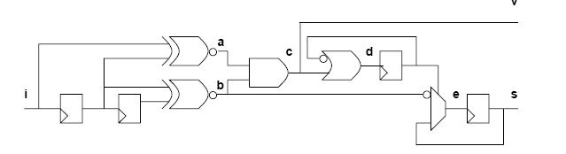
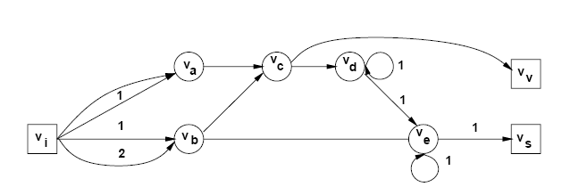
Example
Notes:
Simple circuit and synchronous logic network.
Note that the graph has loops and weights.
Note also that in general it is a multi-graph, as two distinguished edges may join two nodes. For example, such edges may differ in weight.

Slide 34
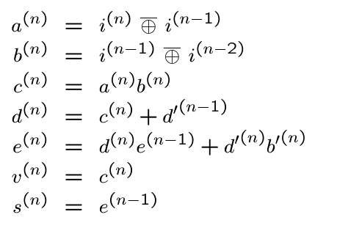
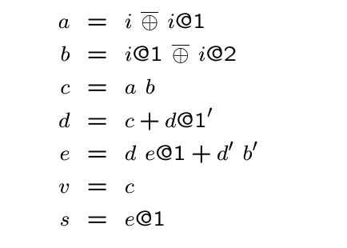
Example
Notes:
A logic network can be represented by a set of statements, where variables have an integer time stamp. On the left, you see a representation in normal form, where all LHS have label (n). On the right, you see a shorthand notation.
All time labels are dropped, except the offsets to the current time (n), which is reported after the symbol @.
The two representations are equivalent.

Slide 35
Approaches to sequential synthesis
Optimize combinational logic only
  Freeze circuit at register boundary
  Modify equation and network graph topology
Retiming
  Move register positions. Change weights on graph
  Preserve network topology
Synchronous transformations
  Blend combinational transformations and retiming
  Powerful, but complex to use
Notes:
There are different approaches to optimizing synchronous networks.
The simplest is to ignore the registers and to optimize the combinational component, using techniques of combinational logic synthesis.
This is equivalent to deleting the edges with positive weights, and to optimizing the corresponding combinational logic network. Needless to say, the removal of the registers from the network segments the circuit and weakens the optimality.
A radically different approach is retiming. By retiming a network, we move the position of the registers only. Hence we do not change the graph topology, but we modify the weight set.
The most general approach to synchronous logic optimization is to perform network transformations that blend retiming with combinational transformations.
Such transformations can have the algebraic or Boolean flavor.

Slide 36
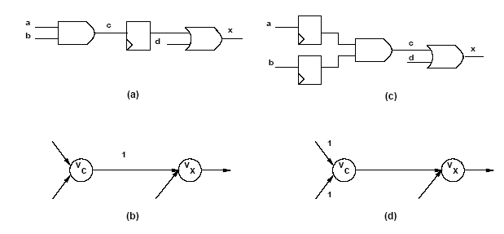
Example of local retiming
Notes:
This slide shows the retiming of an and gate, and the corresponding changes in the representative graph.

Slide 37
Retiming
Global optimization technique
Change register positions
  Affects area:
    Retiming changes register count
  Affects cycle-time:
    Changes path delays between register pairs
Retiming algorithms have polynomial-time complexity
Notes:
Retiming algorithms address the problem of minimizing the cycle-time or the area of synchronous circuits by changing the position of the registers. Recall that the cycle-time is bounded from below by the critical path delay in the combinational component of a synchronous circuit, i.e. by the longest path between a pair of registers.
Hence retiming aims at placing the registers in appropriate positions, so that the critical paths they embrace are as short as possible.
Moving the registers may increase or decrease the number of registers. Thus, area minimization by retiming corresponds to minimizing the overall number of registers, because the combinational component of the circuit is not affected.

Slide 38
Retiming assumptions
Delay is constant at each vertex
  No fanout delay dependency
Graph topology is invariant
  No logic transformations
Synchronous implementation
  Cycles have positive weights
    Each feedback loop has to be broken by at least one register
  Edges have non-negative weights
    Physical registers cannot anticipate time
Consider topological paths
  No false path analysis
Notes:
The classic approach to retiming is based on a few assumptions, which include that the vertex delay is constant, that the graph topology is invariant and that topological critical paths are used. Recent work has removed these restrictions, but we describe here the classic approach.
Retiming applies to synchronous circuits, whose feedbacks go always through at least one register.

Slide 39
Retiming
Retiming of a vertex v
  Integer r_{v}
  Registers moved from output to input: r_{v} positive
  Registers moved from input to output: r_{v} negative
Retiming of a network
  Vector whose entries are the retiming at various vertices
A family of I/O equivalent networks are specified by:
  The original network
  A set of vectors satisfying specific constraints
    Legal retiming
Notes:
Retiming a vertex means moving registers from its outputs to its inputs, or vice versa.
When this is possible, the retiming of a vertex is an integer that measures the amount of synchronous delays that have been moved.
A positive value corresponds to shifting registers from the outputs to the inputs, a negative one to the opposite direction.
The retiming of a network is represented by a vector whose elements are the retiming values for the corresponding vertices.
Given a network, a non-trivial retiming vector specifies another equivalent network, when the retiming vector is legal, i.e., it satisfies some specific constraints.

Slide 40
Example
7
7
7
Original graph
v_{g}
0
0
Delay: 24
v_{f}
v_{e}
0
0
3
0
0
0
0
v_{d}
v_{h}
3
3
3
1
v_{b}
1
v_{a}
v_{c}
1
1
7
7
7
v_{g}
1
1
Retimed graph
v_{f}
v_{e}
Delay: 13
0
0
3
0
v_{d}
v_{h}
1
0
0
3
3
3
0
v_{b}
1
v_{a}
v_{c}
1
0
Notes:
This example is to show the power of retiming as a performance optimization technique.
The top network is a circuit before retiming, with critical path delay = 24.
It has 4 registers.
The bottom network is a circuit after retiming, with critical path delay = 13.
Its frequency of operation has almost doubled, at the cost of an additional register.

Slide 41
Definitions and properties
Definitions:
  w( v_{i}, v _{j}) weight on edge ( v_{i}, v_{j} )
  ( v_{i}, …, v_{j} ) path from v_{i} to v_{j}
  w( v_{i}, …, v_{j} ) weight on path from v_{i} to v_{j}
  d( v_{i}, …, v_{j} ) combinational delay on path from v_{i} to v_{j}
Properties:
  Retiming of an edge ( v_{i}, v_{j} )
    ŵ_{ij} = w_{ij} + r_{j} – r_{i}
  Retiming of a path ( v_{i}, …, v_{j} )
    ŵ ( v_{i}, …, v_{j}) = w (v_{i}, …, v_{j}) + r_{j} – r_{i}
  Cycle weights are invariant
w_{ij}
v_{i}
v_{j}
Notes:
With edge weights denoting registers and node weights delays, it is possible to extend the notion of weight and delay to paths.
Next, it is straightforward to determine the change of the edge (and path) weights due to retiming. Note that retiming does not change cycle weights. As a result, if a circuit is correctly designed as a synchronous circuit (all feedback contain at least a register), then retiming preserves this property.

Slide 42
Legal retiming
A retiming vector is legal iff:
  No edge weight is negative
    ŵ_{ij} ( v_{i}, v_{j}) = w_{ij} (v_{i}, v_{j}) + r_{j} – r_{i} ≥ 0 for all i, j
  Given a clock period φ:
  Each path ( v_{i}, …, v_{j}) with d ( v_{i}, …, v_{j}) > φ
  has at least one register:
    ŵ ( v_{i}, …, v_{j}) = w (v_{i}, …, v_{j}) + r_{j} – r_{i} ≥ 1 for all i, j
  Equivalently, each combinational path delay is less than φ
Notes:
A retiming is legal if the following two conditions apply:
Retiming keeps the edge weight non-negative (as negative weights cannot be implemented by registers that would be non causal)
Each combinational path delay between any two registers is shorter than the cycle time.
Note that the cycle time is given, and the last property can be verifying that all r paths whose delay is larger than the cycle time have at least a register.

Slide 43
Refined analysis
Least-register path
  W (v_{i}, v_{j}) = min w (v_{i}, …, v_{j}) over all paths between v_{i} and v_{j}
Critical delay:
  D (v_{i}, v_{j}) = max d (v_{i}, …, v_{j}) over all paths between v_{i} and v_{j}
  with weight W (v_{i}, v_{j})
There exist a vertex pair (v_{i}, v_{j}) whose delay D (v_{i}, v_{j}) bounds the cycle time
Notes:
Instead of considering all paths, we zoom on those paths that are relevant.
Namely, given two nodes, such paths are those with the least register count, as they are the first that become combinational (if they are not already) when retiming is applied.
Thus, the critical delay between two vertices is the maximum delay on such paths.

Slide 44
Example
7
7
7
v_{g}
0
0
v_{f}
v_{e}
0
0
3
0
v_{d}
v_{h}
0
0
0
3
3
3
1
v_{b}
1
v_{a}
v_{c}
1
1
Vertices: v_{a}, v_{e}
Paths: (v_{a}, v_{b}, v_{c} , v_{e}) and (v_{a}, v_{b}, v_{c}, v_{d}, v_{e})
W(v_{a}, v_{e}) = 2
D(v_{a}, v_{e}) = 16
Notes:
Consider vertices v_a , v_e . There are two paths from v_a to v_e , namely (v_a,v_b,v_c,v_e) and (v_a,v_b,v_c,v_d,v_e) with weights 2 and 3 respectively.
Hence the former path matters, and the critical delay is D(v_a,v_e) = 16 .

Slide 45
Minimum cycle-time retiming problem
Find the minimum value of the clock period φ
such that there exist a retiming vector where:
  r_{i} – r_{j} ≤ w_{ij} for all ( v_{i}, v_{j} )
    All registers are implementable
  r_{i} – r_{j} ≤ W (v_{i}, v_{j}) – 1 for all ( v_{i}, v_{j} ) such that D (v_{i}, v_{j}) > φ
    All timing path constraints are satisfied
Solution
  Given a value of φ
  Solve linear constraints A r ≤ b
    Mixed integer-linear program
  A set of inequalities has a solution if the constraint graph has no positive cycles
    Bellman-Ford algorithm – compute longest path
  Iterative algorithm
    Relaxation
Notes:
The crux of retiming is checking for feasibility. Given a cycle time, there is a legal retiming that makes the circuit to operate at that speed if two sets of constraints are satisfied. Note that the first set is static, i.e., depends on the graph topology, while the latter is dynamic, i.e., the shorter the clock period the more the constraints.
Legality of a retiming vector is equivalent to checking linear constraints.
There are several possible approaches. A convenient way is to transform the linear inequalities into a longest path problem. The inequalities are contradictory iff the corresponding graph has a positive cycle. If this is not the case, the longest path gives the retiming vector entries.

Slide 46
Minimum cycle-time retiming algorithm
Compute all pair path weights W (v_{i}, v_{j}) and delays D (v_{i}, v_{j})
  Warshall-Floyd algorithm with complexity O( |V|³ )
Sort the elements of D (v_{i}, v_{j}) in decreasing order
  Because an element of D is the minimum φ
Binary search for a φ in D (v_{i}, v_{j}) such that
  There exists a legal retiming
  Bellman-Ford algorithm with complexity O( |V|³ )
Remarks
  Result is a global optimum
  Overall complexity is O( |V|³ log |V| )
Notes:
A naive way to minimize the cycle-time in a network is to check is there exists a feasible retiming for decreasing values of the cycle time. For each tentative value of the cycle time, the set of inequalities is constructed, and a solution is sought for by invoking the Bellman-Ford algorithm.
A more efficient search can be done by noticing that the optimum cycle-time must match a path delay, for some vertex pair v_i, v_j. More specifically, in any network there exist a vertex pair v_i,v_j, such that the corresponding path delay equals the optimum cycle-time. Hence a binary search among the path delays provides the candidate values for the cycle-time, that are checked for feasibility by the Bellman-Ford algorithm.
The overall worst-case computational complexity is O(|V|3 log |V|), where the cubical term is due to the Bellman-Ford algorithm and the logarithmic one to the binary search. This is the original algorithm proposed by Leiserson and Saxe.

Slide 47
Example: original graph
7
7
7
v_{g}
0
0
v_{f}
v_{e}
0
0
3
0
v_{d}
v_{h}
0
0
0
3
3
3
1
v_{b}
1
v_{a}
v_{c}
1
1
Constraints (first type):
  r_{a} - r_{b} ≤ 1 or equivalently r_{b} ≥ r_{a} – 1
  r_{c} - r_{b} ≤ 1 or equivalently r_{c} ≥ r_{b} – 1
  …
Notes:
This example shows the original graph, as well as the static constraints that insure that no edge has a negative weight after retiming.

Slide 48
Example: constraint graph
7
7
7
r_{g}
0
0
r_{f}
r_{e}
0
0
3
0
r_{d}
r_{h}
0
0
0
3
3
3
-1
r_{b}
-1
r_{a}
r_{c}
-1
-1
Constraints (first type):
  r_{a} - r_{b} ≤ 1 or equivalently r_{b} ≥ r_{a} – 1
  r_{c} - r_{b} ≤ 1 or equivalently r_{c} ≥ r_{b} – 1
  …
-1
r_{a}
r_{b}
Notes:
This graph is called constraint graph. It is obtained from the original graph by reversing the signs. Note that this graph represents the static constraints.
Note that this graph represents the constraint for an infinitely slow clock rate.
Additional constraints related to the clock period are described in the sequel.

Slide 49
Example
Sort elements of D:
  33,30,27,26,24,23,21,20,19,17,16,14,13,12,10,9,7,6,3
Select φ = 19
  33,30,27,26,24,23,21,20,19,17,16,14,13,12,10,9,7,6,3
  Pass: legal retiming found
Select φ = 13
  33,30,27,26,24,23,21,20,19,17,16,14,13,12,10,9,7,6,3
  Pass: legal retiming found
Select φ < 13
  33,30,27,26,24,23,21,20,19,17,16,14,13,12,10,9,7,6,3
  Fail: no legal retiming found
Fastest cycle time is φ = 13. Corresponding retiming vector is used
Notes:
This slide shows the outer shell of the algorithm.
The path delays, once sorted, are: (33,30,27,26,24,23,21,20,19,17,16,14,13,12,10,9,7,6,3) .
The algorithm would then compute the inequalities that can be represented by the constraint graph.
The binary search selects first the clock period=19 .
Then the clock-dependent constraints are constructed (see next slide), and the Bellman-Ford algorithm is applied. Since no positive cycle is detected, a feasible retiming exists for a cycle-time of 19 units.
Then, a clock period = 13 is selected.
Again, the inequalities are computed, and the Bellman-Ford algorithm is applied. Since no positive cycle is detected, a feasible retiming exists for a cycle-time of 13 units.
Last, other clock periods shorter than 13 are tried. In all these cases, a positive cycle is found and there is no legal retiming. Thus 13 and its corresponding retiming is retained as the optimum solution.

Slide 50
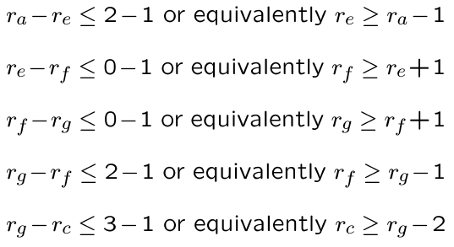
Example φ = 13
1
1
r_{g}
0
0
r_{f}
r_{e}
0
-1
0
r_{h}
-1
r_{d}
0
0
0
-2
-1
r_{b}
-1
r_{a}
r_{c}
-1
-1
Notes:
This constraint graph shows, in addition to the static constraints, the constraints that any path, with delay larger than 13, needs to have a register.
Equivalently, there is an edge between all vertex pairs that are endpoint of such paths, with a weight that guarantees that such path has at least a register after retiming.

Slide 51
Example φ = 13
-1
Constraint graph:
Longest path from source
  -[12232100]
Retimed graph
1
1
r_{g}
0
0
r_{f}
r_{e}
0
-1
0
r_{h}
-1
r_{d}
0
0
0
-2
-1
r_{b}
-1
r_{a}
r_{c}
-1
-1
7
7
7
v_{g}
1
1
v_{f}
v_{e}
1
0
3
0
v_{d}
v_{h}
1
1
0
3
3
3
0
v_{b}
0
v_{a}
v_{c}
0
1
Notes:
Please note that this graph has no positive cycles.
Hence the inequalities are consistent.
A longest path from the origin gives the required retiming.

Slide 52
Example φ = 13
The solution is not unique
7
7
7
v_{g}
1
1
v_{f}
v_{e}
1
0
3
0
v_{d}
v_{h}
1
1
0
3
3
3
0
v_{b}
0
v_{a}
v_{c}
0
1
7
7
7
v_{g}
1
1
v_{f}
v_{e}
0
0
3
0
v_{d}
v_{h}
1
0
0
3
3
3
0
v_{b}
1
v_{a}
v_{c}
1
0
Notes:
This slide shows the original and the retimed graph.
Note that solution is not unique.

Slide 53
Relaxation-based retiming
Most common algorithm for retiming
  Avoids storage of matrices W and D
  Applicable to large circuits
Rationale
  Search for decreasing φ in fixed step
    Look for values of φ compatible with peripheral circuits
  Use efficient method to determine legality
    Network graph is often very sparse
  Can be coupled with topological timing analysis
Notes:
Even though the classic retiming algorithm has polynomial-time complexity, its run time may be high. Computing and storing all pair path weights and delays, especially when the network is large. It is also inefficient when the network is sparse.
A relaxation method can be used to check the existence of a feasible retiming for a given cycle-time. This step can replace the Bellman-Ford algorithm.
The algorithm uses the notion of data-ready time at each vertex, which is equal to the data-ready time of the combinational network obtained by deleting the edges with positive weights.

Slide 54
Relaxation-based retiming
Start with a given cycle-time φ
Look for paths with excessive delays
Make such paths shorter
  By bringing the terminal register closer
  Some other paths may become longer
  Namely, those path whose tail has been moved
Use an iterative approach
Notes:
The relaxation algorithm looks for paths with excessive delays, and moves backward the head register to make them feasible. Unfortunately, since these registers are heads of other paths, then these paths may no longer be feasible. For this reason, the process needs to be iterated.

Slide 55
Relaxation-based retiming
Define data ready time at each node
  Total delay from register boundary
Iterative approach
  Find vertices with data ready > φ
  Retime these vertices by 1
Algorithm properties
  If at some iteration there is no vertex with data ready > φ,
  a legal retiming has been found
  If a legal retiming is not found in |V| iterations,
  then no legal retiming exists for that φ
Notes:
The relaxation algorithm is iterative in nature. At each iteration it computes the data-ready times and their maximum value. If this value is less than, or equal to, the given value clock period, the algorithm terminates successfully. Otherwise it searches for all those vertices whose data-ready times exceed the cycle-time, i.e. those vertices where the output signals is generated too late to be stored in a register.
It retimes then these vertices by one unit, i.e. it moves registers backwards along those paths whose delay is too large. Since moving registers may create timing violations on some other paths, the process is iterated until a feasible retiming is found. A remarkable property of the algorithm is that, when the algorithm fails to find a solution in |V| iterations, then no feasible retiming exists for the given clock period.

Slide 56
Example φ = 13 iteration = 1
7
7
7
7
7
7
v_{g}
0
0
v_{f}
v_{e}
v_{g}
v_{f}
v_{e}
0
0
3
3
0
v_{d}
0
v_{h}
0
0
0
v_{h}
v_{d}
3
3
3
3
3
3
1
v_{b}
1
v_{a}
v_{c}
v_{a}
v_{b}
v_{c}
1
1
Notes:
Let us compute the data-ready times. Recall that cutting the edges with positive weights determines the combinational component of the circuit.
Thus, we can perform a network traversal starting from the vertices that are heads of edges with positive weights, that yields:
t_a = 3; t_b =3; t_c = 3; t_d = 3; t_e = 10; t_f =17; t_g = 24; t_h =24 .
Hence the subset of vertices to be retimed is { t_f, t_g, t_h } .

Slide 57
Example φ = 13 iteration = 2
7
7
7
7
7
7
v_{g}
0
1
v_{f}
v_{e}
v_{g}
v_{f}
v_{e}
0
0
3
3
0
v_{d}
v_{h}
0
v_{d}
1
1
0
v_{h}
3
3
3
3
3
3
0
v_{b}
1
v_{a}
v_{c}
v_{a}
v_{b}
v_{c}
1
1
Notes:
The retimed network is shown above with the new edge weights.
We consider again the combinational component and we recompute then the data-ready times. Thus: t_a = 17 ; t_b =3 ; t_c = 3; t_d = 3; t_e = 10; t_f =7; t_g = 14; t_h =14 .
Now the subset of vertices to be retimed is { t_a, t_g, t_h } .

Slide 58
Example φ = 13 iteration = 3
7
7
7
7
7
7
v_{g}
1
1
v_{f}
v_{e}
v_{g}
v_{f}
v_{e}
0
0
3
3
0
v_{d}
v_{h}
0
0
v_{d}
1
1
v_{h}
3
3
3
3
3
3
0
v_{b}
1
v_{a}
v_{c}
v_{a}
v_{b}
v_{c}
0
1
Notes:
The newly retimed network is shown on the left.
We consider again the combinational component and determine the data-ready times, that are: t_a = 10 ; t_b =13 ; t_c = 3; t_d = 3; t_e = 10; t_f =7; t_g = 7; t_h =7 .
The network is timing feasible.

Slide 59
Retiming for minimum area
Find a retiming vector that minimizes the number of registers
Simple area modeling
  Every edge with a positive weight denotes registers
  Total register area is proportional to the sum of all weights
Register sharing model
  Every set of positively-weighted edges with common tail is realized by a shift register with taps
  Total register area is proportional to the sum, over all vertices, of the maxima of weights on outgoing edges
Notes:
Retiming may affect the circuit area, because it may increase or decrease the number of registers in the circuit. Since retiming does not affect the functions associated with the vertices of the network, then the variation of the number of registers is the only relevant factor as far as area optimization by retiming is concerned.
Before explaining the method, let us recall that the synchronous network model splits multi-terminal nets into two-terminal ones. As a result, synchronous delays are modeled by weights on each edge. Consider a vertex with two (or more) fanout stems.
From an implementation standpoint, there is no reason for having independent registers on multiple fanout paths. Registers can be shared.
Nevertheless, retiming is simpler to apply with no register sharing.
Eventually, register sharing can be taken into account by a network transformation.

Slide 60
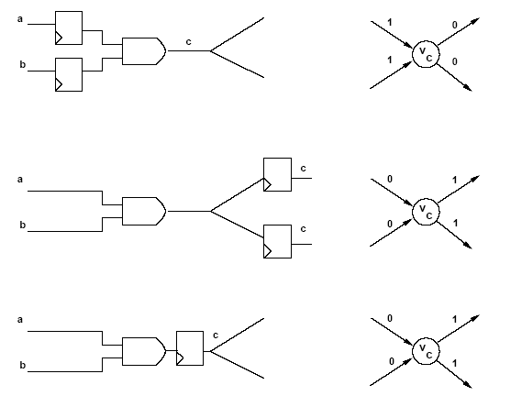
Example
Notes:
This example shows the register sharing on a gate fanout.

Slide 61
Minimum area retiming simple model
Register variation at node v
  r_{v} ( indegree(v) – outdegree(v) )
Total area variation:
  Σ r_{v} ( indegree(v) – outdegree(v) )
Area minimization problem:
  Min Σ r_{v} ( indegree(v) – outdegree(v) )
  Such that r_{i} – r_{j} ≤ w_{ij} for all ( v_{i}, v_{j} )
Notes:
Consider a generic vertex that is retimed by r.
The local variation in register count is r (indegree - outdegree ).
Therefore, the overall variation of registers due to retiming is the sum over all vertices of this quantity. If we add the static constraint that insure that all edges are legal,
We can cast the problem into an integer linear program

Slide 62
Minimum area retiming under timing constraint
Area recovery under timing constraint
  Min Σ r_{v} ( indegree(v) – outdegree(v) ) such that:
  r_{i} – r_{j} ≤ w_{ij} for all ( v_{i}, v_{j} ) and
  r_{i} – r_{j} ≤ W (v_{i}, v_{j}) – 1 for all ( v_{i}, v_{j} ) such that D (v_{i}, v_{j}) > φ
Common implementation is by integer linear program
  Problem can alternatively be transformed into a matching problem and solved by Edmonds-Karp algorithm
Register sharing
  Construct auxiliary network and apply this formulation.
  Auxiliary network construction takes into account register sharing
Notes:
If we consider timing constraints related to a given cycle time, then this constraint can be added in a straightforward way.
This formulation is also the linear programming dual of a minimum-cost flow
problem, that can be solved in polynomial time

Slide 63
Other problems related to retiming
Retiming pipelined circuits
  Balance pipe stages by using retiming
  Trade-off latency versus cycle time
Peripheral retiming
  Use retiming to move registers to periphery of a circuit
  Restore registers after optimizing combinational logic
Wire pipelining
  Use retiming to pipeline interconnection wires
  Model sequential and combinational macros
  Consider wire delay and buffering
Notes:
Retiming is widely applicable to many problems, such as balancing delays in a pipelined circuit.
Peripheral retiming is a technique that aims at moving registers to the periphery of a circuit, so that a large combinational component can be optimized by a combinational logic transformations. This is followed by standard retiming.
Wire pipelining and retiming is of interest in advanced technologies, where propagation delays on wires need to be optimized by pipelining.

Slide 64
Summary of retiming
Sequential optimization technique for:
  Cycle time or register area
Applicable to
  Synchronous logic networks
  Architectural models of data paths
    Vertices represent complex (arithmetic) operators
  Exact algorithm in polynomial time
Extension and issues
  Delay modeling
  Network granularity
Notes:
In summary, retiming is widely applicable. It can be used at the logic abstraction level (where vertices represent logic gates) and at the architectural abstraction level (where vertices represent data path elements.
The algorithm is exact under mild assumptions; when these are not satisfied the algorithm still gives good heuristic solutions in a short computation time.

Slide 65
Module 3
Objective
  Relating state-based and structural models
  State extraction

Slide 66
Relating the sequential models
State encoding
  Maps a state-based representation into a structural one
State extraction
  Recovers the state information from a structural model
Remark
  A circuit with n registers may have 2^{n} states
  Unreachable states
Notes:
The structural and state-based models of synchronous circuits are related.
State encoding maps a state-based representation into a structural one.
State extraction does the reverse step.
Note that the state set size explodes quickly, as it grows exponentially with the number of registers. Circuits with 20 registers are very common and not even considered large, while 2exp20 is a large number. Thus, it is important that only reachable states are taken into account, because they are the only relevant ones. Implicit methods have been devised for FSM traversals that avoid the explicit state enumeration.

Slide 67
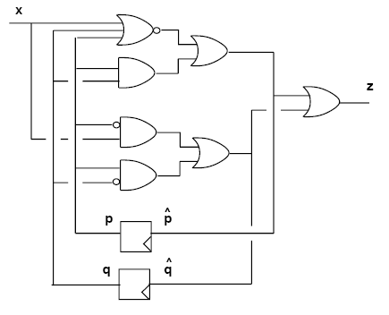
State extraction
State variables: p, q
Initial state p=0; q=0;
Four possible states
Notes:
Consider the synchronous network with one input ( x ), one output ( z ) and two state variables ( p,q ).
Let the reset state correspond to the state assignment p = 0 ; q = 0 .
There are at most four states, corresponding to the different polarity assignments of p and q .
We question if all four states are reachable from the reset state.
Next we shall attempt to construct a consistent state-transition diagram.

Slide 68
State extraction
Reachability analysis
  Given a state, determine which states are reachable for some inputs
  Given a state subset, determine the reachable state subset
  Start from an initial state
  Stop when convergence is reached
Notation:
  A state (or a state subset) is represented by an expression over the state variables
  Implicit representation
Notes:
We consider first an intuitive method for reachability analysis.
We are given the transition function f that maps present states into next states under some inputs.
We define a procedure that given a state (or a state set) yields the reachable states.
We capture these states as a Boolean function, represented as a BDD.
Starting from the reset state, we iterate this procedure until we find a fixed point.
The fixed point represents the reachable states.

Slide 69
Reachability analysis
State transition function: f
Initial state: r₀
States reachable from r₀
  Image of r₀ under f
States reachable from set r_{k}
  Image of r_{k} under f
Iteration
  r_{k+1} = r_{k} U ( image of r_{k} under f)
Convergence
  r_{k+1} = r_{k} for some k
Notes:
Let r_0 represent the reset state in terms of the state variables.
The states directly reachable from r_0 are the image of r_0 under f and can be expressed implicitly as a function of the state variables.
Similarly, the states directly reachable from any state set represented implicitly by r_k are the image of r_k under f .
By defining r_k+1 to be the union of r_k and the image of r_k under f , we specify an iterative method for implicit reachability computation.
The iteration terminates when a fixed point is reached,
i.e. when r_k = r_k+1 for some value of k. It terminates in a finite number of steps.
At the fixed point, the expression for r_k encapsulates all reachable states, whereas
its complement denotes unreachable states and represents dc conditions that can be used to optimize the circuit.

Slide 70
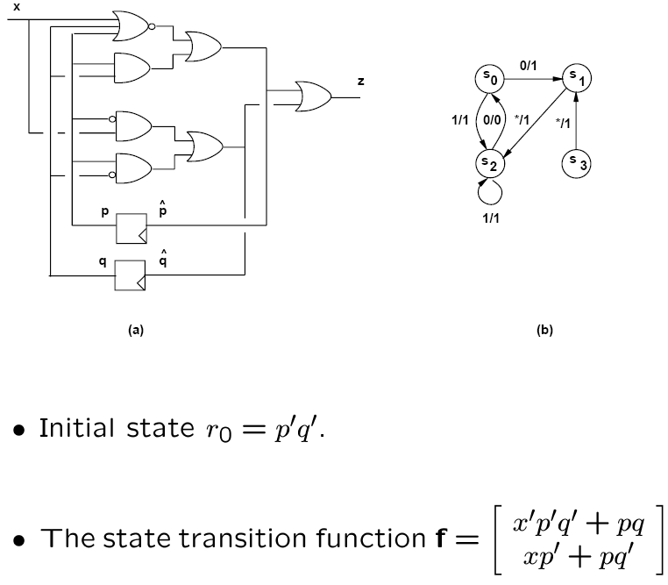
Example
Notes:
Consider again the synchronous network with a reset state is represented by (p=0; q=0). Thus r_0 = p'q'.
The state transition function is a vector, whose two components yield the next values for p and q for a given input x.
The state diagram on the right is not yet known at this stage. It is reported here to show the objective of this computation.

Slide 71
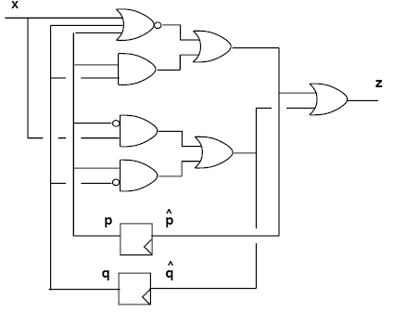
Example
Image of p’q’ under f:
  When ( p = 0 and q = 0 ), f reduces to [ x’ x ]^{T}
  Image is [ 0 1 ]^{T} U [ 1 0 ]^{T}
States reachable from the reset state:
  (p = 1; q = 0) and ( p = 0; q = 1)
  r₁ = p’q’ + pq’ + p’q = p’ + q’
States reacheable from r₁:
  [ 0 0 ]^{T} U [ 0 1 ]^{T} U [ 1 0 ]^{T}
Convergence:
  s₀ = p’q’; s₁ = pq’; s₂ = p’q;
Notes:
The image of p'q' under f can be derived intuitively by considering that when (p=0; q=0) the function f reduces to [ x’ x] whose range is represented by vectors [01] and [10] .
Equivalently, the states reachable from the reset state are encoded as: (p=1; q=0) and (p=0; q=1) .
Therefore r_1 = p'q' + pq' + p'q = p' + q' .
The image of r_1 under f is r_2 = p' + q' = r_1.
Thus the iteration has converged.

Slide 72
Completing the extraction
Determine state set
  Vertex set
Determine transitions and I/O labels
  Edge set
  Inverse image computation
  Look at conditions that lead into a given state
Notes:
The forward traversal allows us to determine that the FSM has 3 reachable states.
Now that the state set has been identified, the state-transition diagram can be constructed by determining the transitions which correspond to the edges of the graph.
The transition edges and the qualifying inputs on the edges can be derived by computing the inverse image of the head state representation under f.

Slide 73
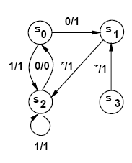
Example
Transition into s₀ = p’q’
  Patterns that make f = [ 0 0 ]^{T} are:
  (x’p’q’ + pq)’(xp’ + pq’)’ = x’p’q
  Transition from state s₂ = p’q under input x’
  And so on …
s0
s1
0
s2
Notes:
Transitions into s_0 corresponding to p'q' are identified by those patterns that make f = [ 0 0].
Equivalently, they satisfy (x'p'q' + pq)'(xp' + pq')' = x'p'q .
Hence there is a transition into state s_0 from state s_2 (encoded as p'q ) under input x' .
The corresponding primary output can be derived by evaluating the network in a straightforward way.
In this case, input x=0 and state p'q yield z=0 .

Slide 74
Remarks
Extraction is performed efficiently with implicit methods
Model transition relation χ (i,x,y) with BDDs
  This function relates possible triples:
    ( input, current_state, next_state )
  Image of r_{k}:
    S_{i,x} ( χ(i,x,y) r_{k} (x) )
    Where r_{k} depends on inputs x
  Smoothing on BDDs can be achieved efficiently
Notes:
Reachability analysis can be performed using the state-transition relation, which is the characteristic equation of the state-transition function, and can be efficiently represented as a ROBDD.
Namely, the transition relation links possible triples of inputs, present states and next-states.
The image of r_k under the state-transition function can be computed by ANDing the relation with the representation of r_k and by smoothing out the inputs x.
These operations are efficiently done with BDDs.

Slide 75
Summary
State extraction can be performed efficiently to:
  Apply state-based optimization techniques
  Apply verification techniques
State extraction is based on forward and backward state space traversal:
  Represent state space implicitly with BDDs
  Important to manage the space size, which grows exponentially with the number of registers
Notes:
State extraction is useful for both synthesis and verification.
It can be done efficiently via implicit traversal in forward and backward direction of the transition relation, which in turn can be derived from a structural representation of the network.
With this formalism, it has been possible to develop algorithms for FSM traversal applicable to sequential circuits with potential large state sets (e.g. 10exp60).

